Slide 1

PRODUCT RECOMMENDATION SYSTEMS
MEMBERS:
SHAIVEE KATIYAR (A013)
MAITREE KATIYAR (A011)
QASIM ABBAS GHEEWALA (A006)
Guided by:
PROF. SHRADDHA SARODE

Slide 2
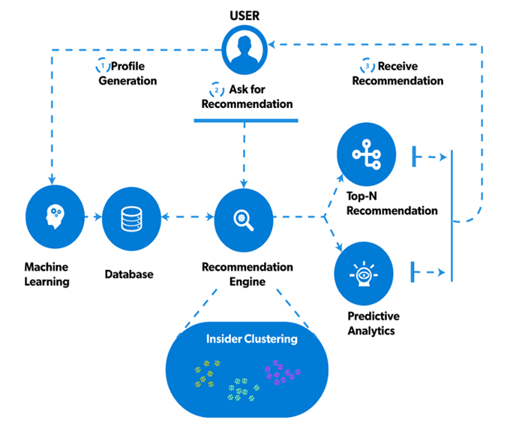
Introduction
Recommender Systems are a particular type of personalized Web-based applications that provide to users personalized recommendations about content they may be interested in.
Most of today’s internet businesses deeply root their success in the ability to provide users with strongly personalized experiences

Slide 3




01
02
03
04
Recommendation Engine - Examples
Facebook- "People you may know"
Netflix-"Other Movies you may Enjoy"
Amazon-”customer who bought this item
LinkedIn-"Jobs you may be interested in"

Slide 4
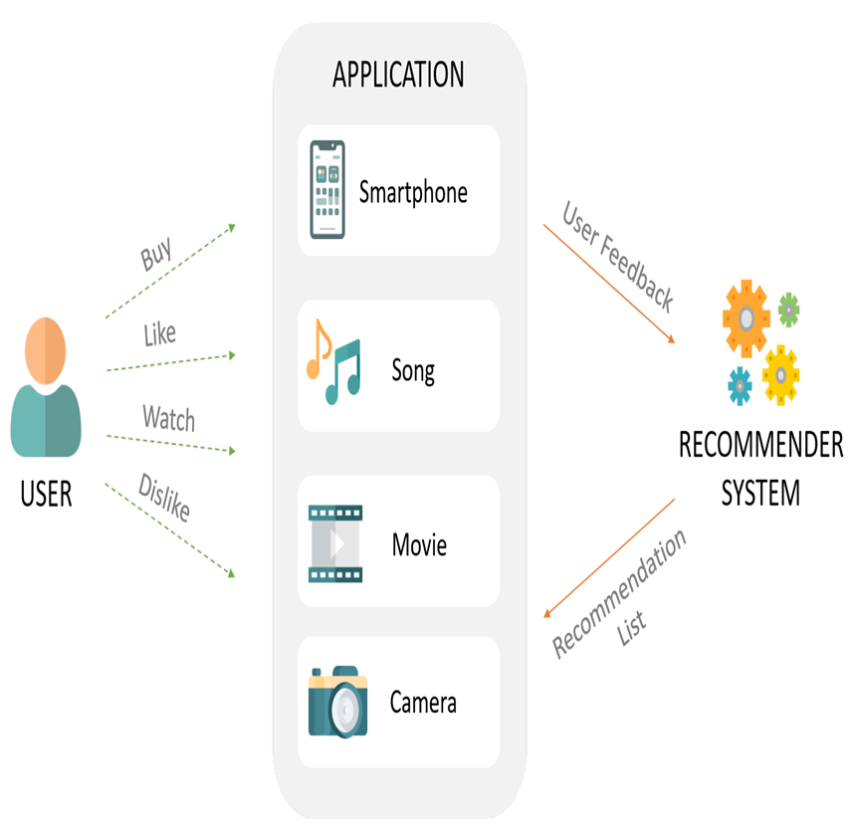
For Users
Need For Recommendation System
To get personalized recommendations.
Help users to take correct decisions in their
online transactions.
To increase sales
To retain the customers
To enhance user shopping experience
For Company

Slide 5
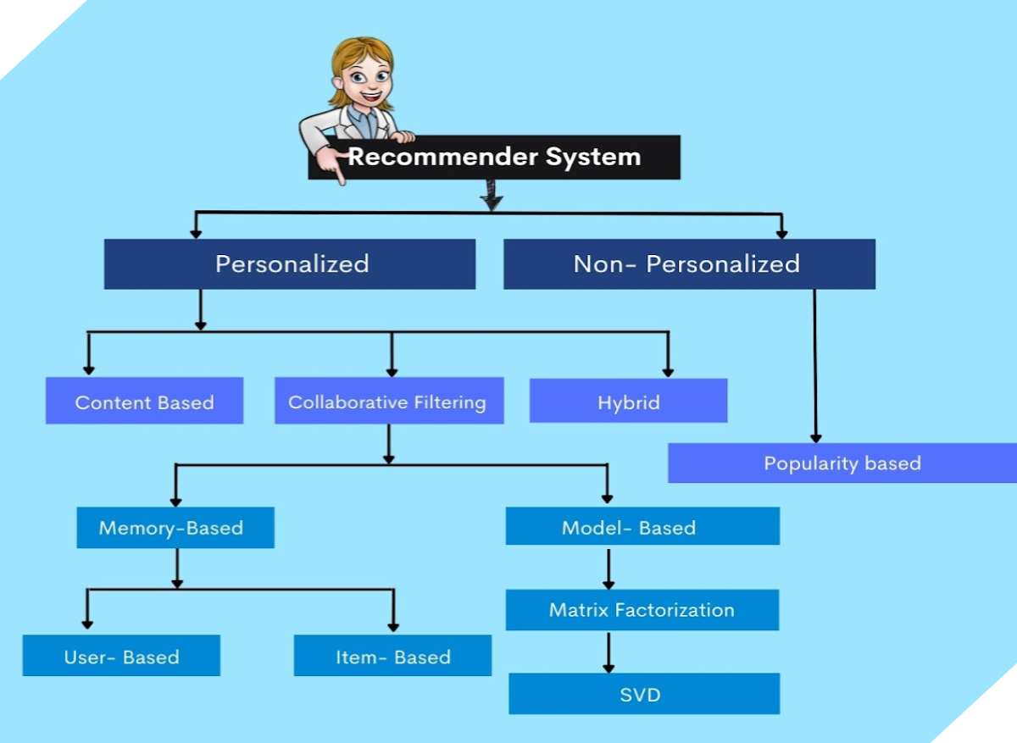
Types Of Recommendation System

Slide 6
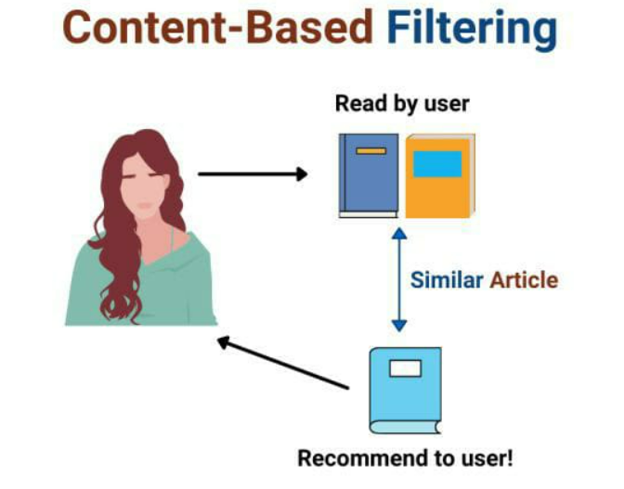
Content Based Filtering
Content Based Filtering system is dependent on the inputs provided by the user.
This system uses your features and likes in order to recommend you with things that you might like.
It uses the information provided by you over the internet and the ones they are able to gather and then they curate recommendations according to that

Slide 7
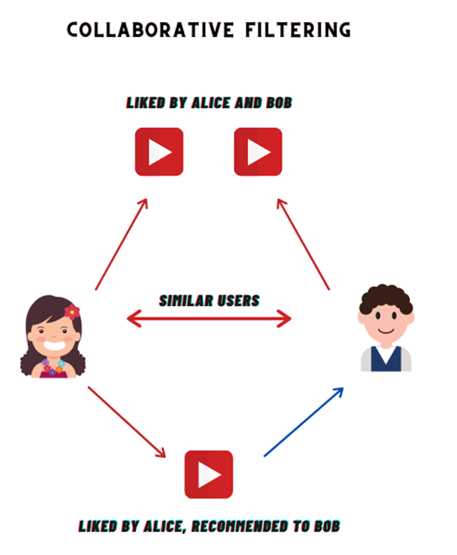
Collaborative Based Filtering
Collaborative filtering is used by most recommendation systems to find similar patterns or information of the users
This technique can filter out items that users like on the basis of the ratings or reactions by similar users
It uses similarities between users and items simultaneously to provide recommendations

Slide 8
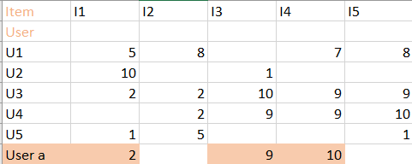
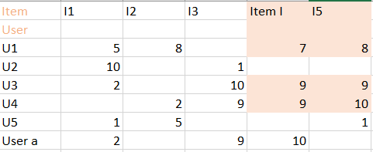


User - Based Collaborative Filtering
Item - Based Collaborative Filtering
User- based collaborative filtering is a technique used to predict the items that a user might like on the basis of ratings given to that item by the other users who have similar taste with that of the target use.
Item-to-item collaborative filtering matches each of the user’s purchased and rated items to similar items, then combines those similar items into a recommendation list.

Slide 9
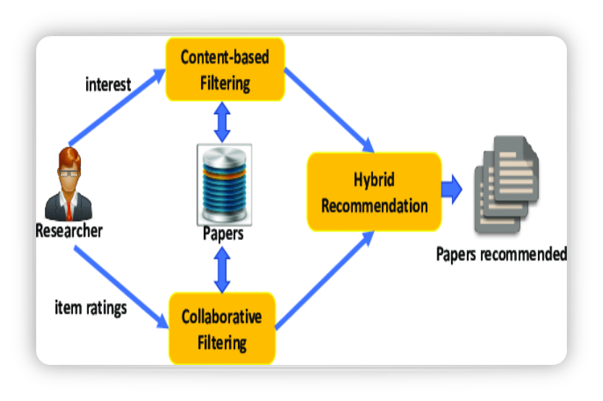
Hybrid System
A hybrid recommendation system is a special type of recommendation system which is the combination of the content and collaborative filtering method.
It is a open source recommender system.
It is used for survey and experiments

Slide 10
Data Description For Amazon Data
Product ID
e.g. B001E4KFG0
Product IDs 5,68,454
Unique Product IDs: 74,258
User ID
e.g. A3SGXH7AUHU8GW
User ids : 5,68,454
Unique User Id: 25,6059
Ratings
Unique ratings : 5
Product Id –It identifiers are a series of numerical or alphanumerical digits that are used to identify a specific product .
user ID -It is an entity used to identify a user
Rating of item – How much the user likes the item on the basis of 1 to 5

Slide 11
Data Description For Sales Data
Customer Id
e.g.-’AA=10315’
Product Id
e.g.-CA-2017-152156
- Unique Product Id- 1862
Order Id e.g.-CA-2017152156
It is the unique numeric identifier that gets generated when you have a new customer on the website.
It is the unique number identifier that
gets generated when you place an order
on our website
It is a unique set of numbers that are used to identify a specific product.
Category
e.g .- Furniture , office supplies, technology
Sub-Category
e.g.-Chairs, storage
Product Name – e.g.- “ Hon Deluxe Fabric upholstered Stacking Chair”
Sub- category is a sub division of a larger category a second category.
Product Name - The name of the product
The category in which the product lies .

Slide 12
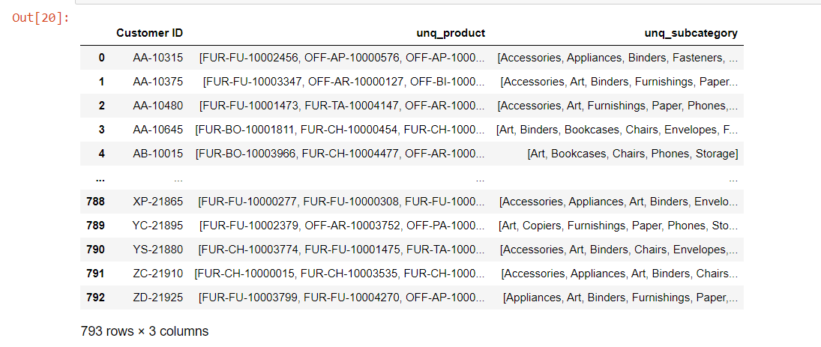
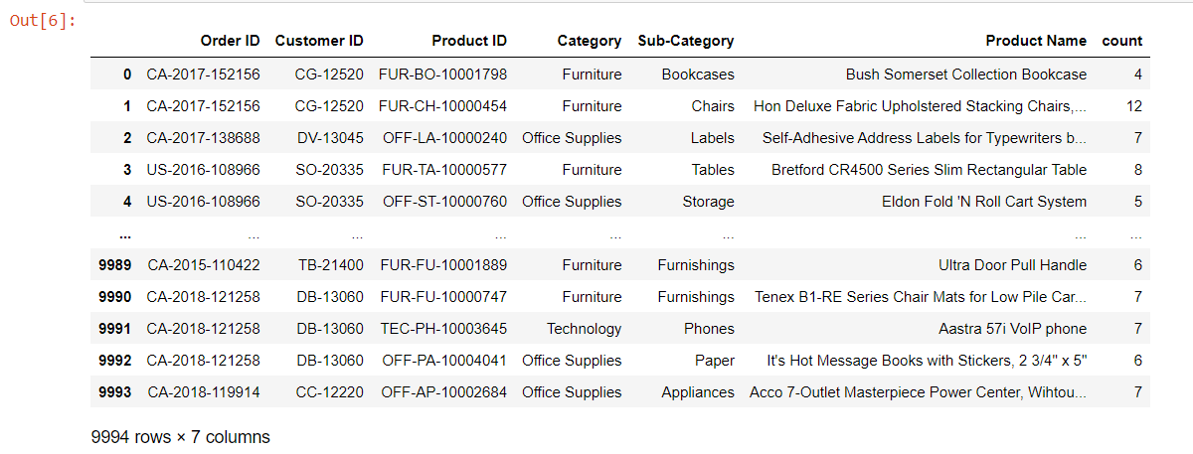
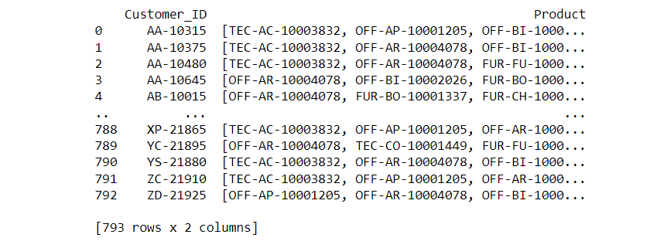
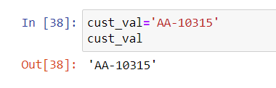
1. Content-Based Filtering
Sales Data
Step 2: df1 has all lists of unique products and subcategories from which the customer has ordered.
Step 1: F_data has all the necessary columns required for analysis and count represents the total no of times each product is bought.
Step 3: final_list has all the unique customers along with the products recommended to them based on their previous buying patterns.

Slide 13
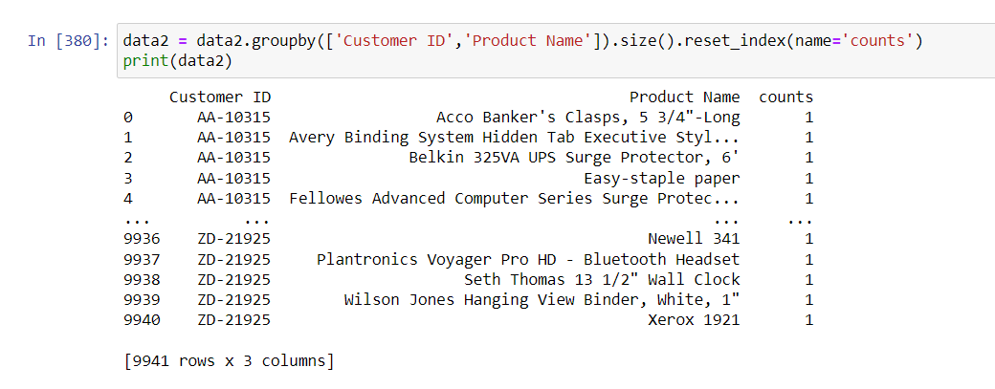
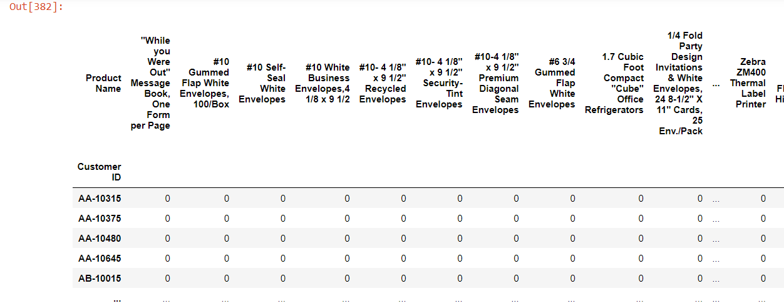
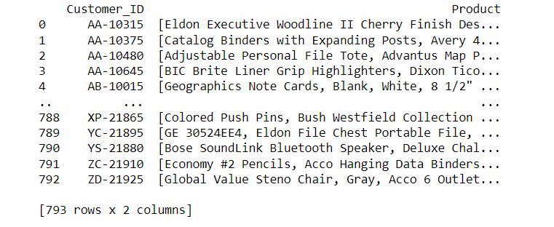
Sales Data
2. Collaborative Based Filtering
Step 1: Grouping the data on the basis of all the products bought by the customers.
Step 2: Forming the pivot table between the customers and all the unique products.
Step 3: The final list has all the unique customers along with all the products recommended to them.

Slide 14
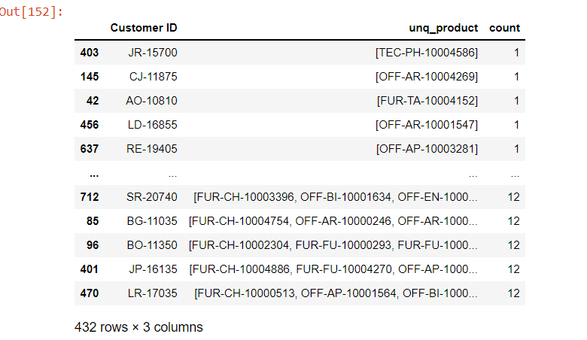
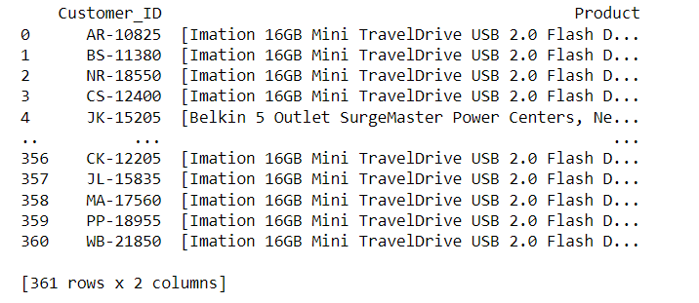
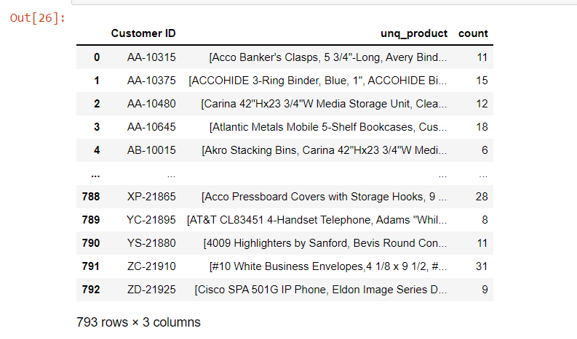
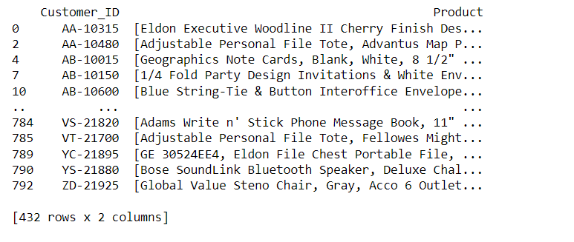
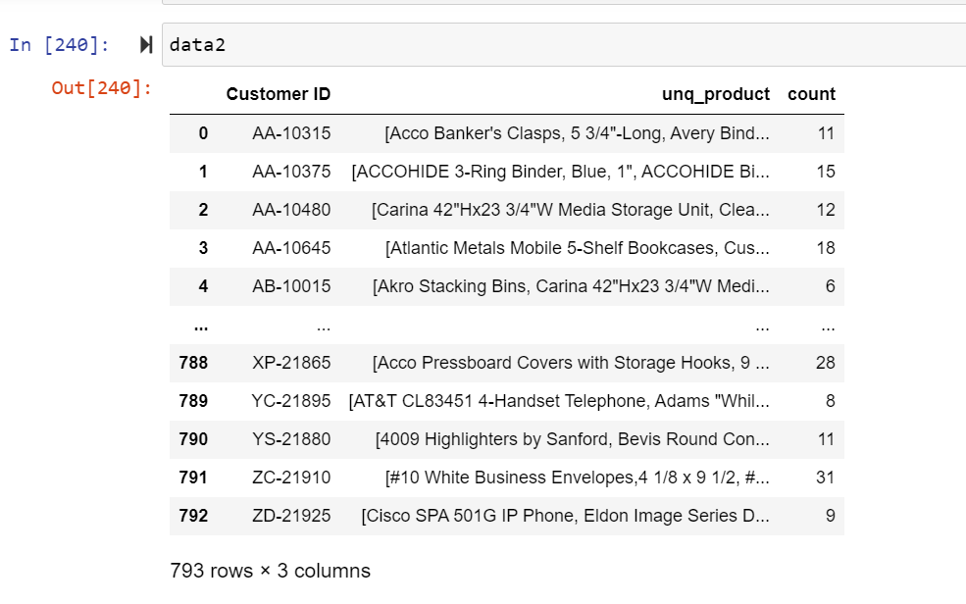
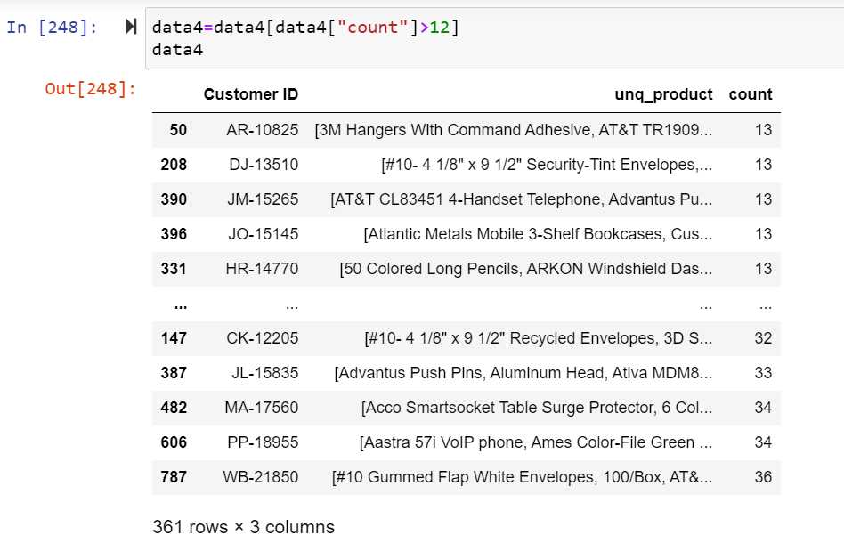
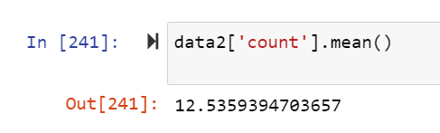
3. Hybrid Filtering
Step 7: The final list after performing the Collaborative- Filtering.
Step 6: Performing Collaborative Filtering on data having count<=12
Step 4:Performing Content –Based Filtering on the data having count>12.
Step 3: Dividing the data based on the average count in two parts.
Step 5: The final list after performing the Content-Based Filtering.
Step 1: Data 2 has a count of list of all the products bought by the customers individually.
Step 2:Mean of the count was coming out to be 12.

Slide 15
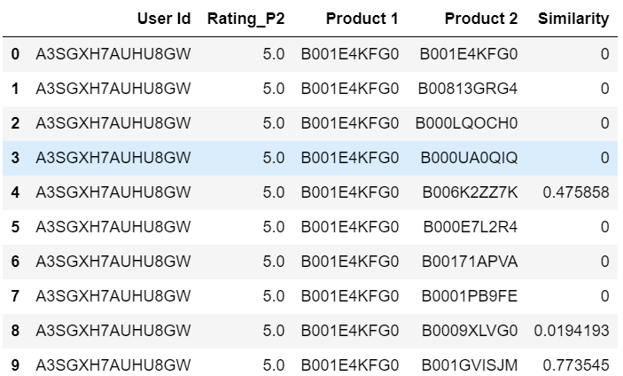
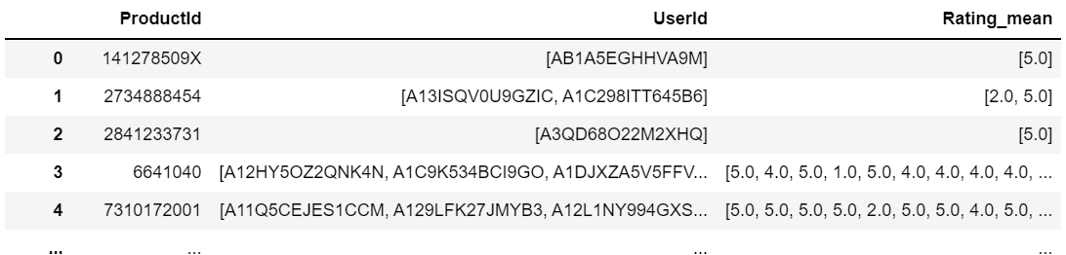
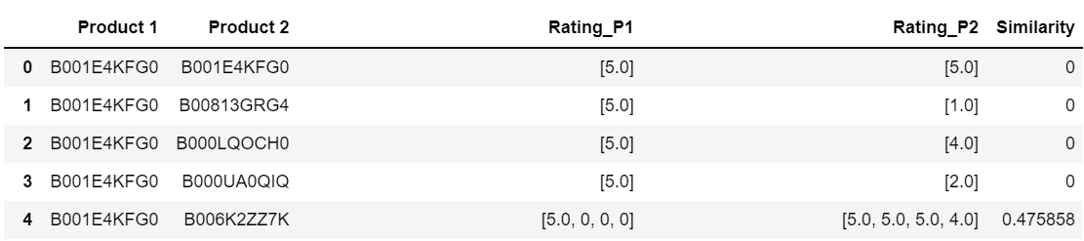
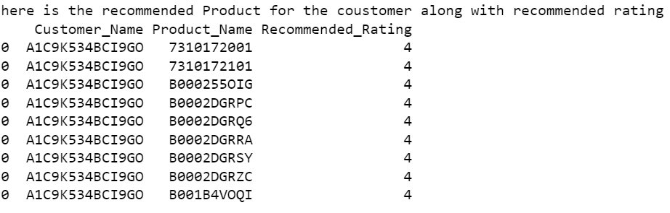
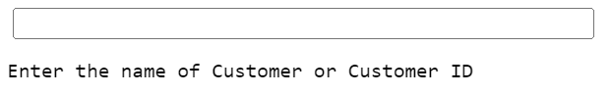
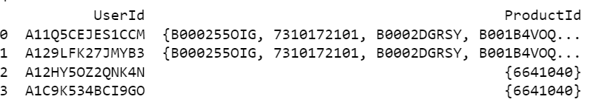
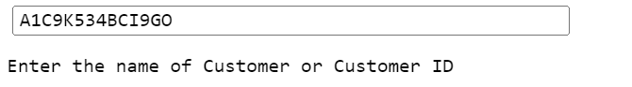
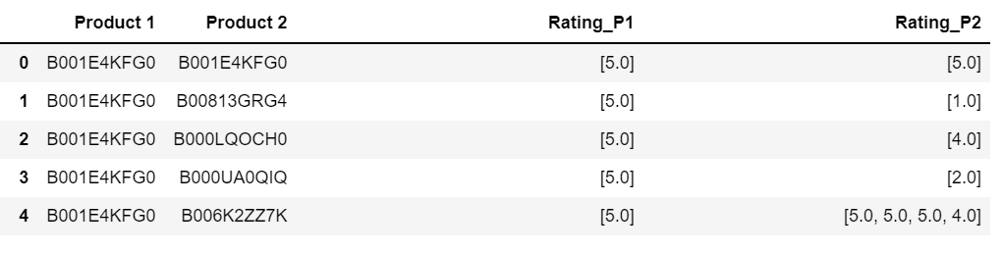
Amazon Data
Collaborative Based Filtering
Step 1: Grouped the User Id and the corresponding Rating for each Product Id.
Step 4: Mapped the User Id .
Step 3: Calculated the Similarity for the combination of Products based on rating.
Step 6: Predicted the Rating of the Product, not bought by the Customer.
Step 5: Grouped all Products that a Customer has bought.
Step 2: Created all the combinations that a Product could have with another Product .

Slide 16

Future Scope
Neural Networks and Deep Learning appears that to be helpful for solving recommendation system problems.
Recommender systems can be a very powerful tool in a company’s arsenal, and future developments.
The scope for product recommendations in
e-commerce is vast, especially with the introduction
of AI for personalized product recommendations.

Slide 17
Conclusion
Recommended Products to the customer using the sales data
using collaborative, content and hybrid method.
Recommended products to customer on Amazon data using collaborative method .
Recommendation system is an information service system that connects users and products.

Slide 18
THANK YOU !!

